Slide 1
MJFF Biomarker Toolkits & Resources
Oct 14, 2026
PD Therapeutics Conference 2026

Slide 2
Biomarker tools to advance PD research & therapeutic development
Develop biology-centered definitions of disease
Ensure robust pipelines that reflect diversity of therapeutic approaches
Improve efficiency of clinical trials with targeted biomarker strategies
01
02
03
BIOMARKERS & MEASUREMENT TOOLS TEAM
TOOLS TO UNDERSTAND
DISEASE BIOLOGY
DRUG DEVELOPMENT TOOLS
Notes:
Highlight that Room D on multimodal data & analyses is TUDB if folks want to learn more

Slide 3
Our goals: advancing assays & sharing resources across the field
Engage community/industry stakeholders to inform prioritization of assay development & disseminate updated biomarker landscape report
01
02
Develop standardized biomarker toolkits for early-phase clinical trials

Slide 4
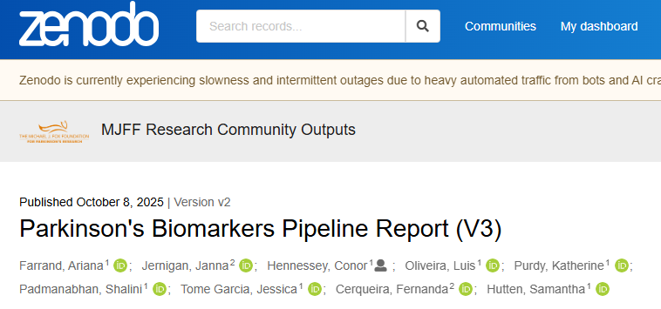
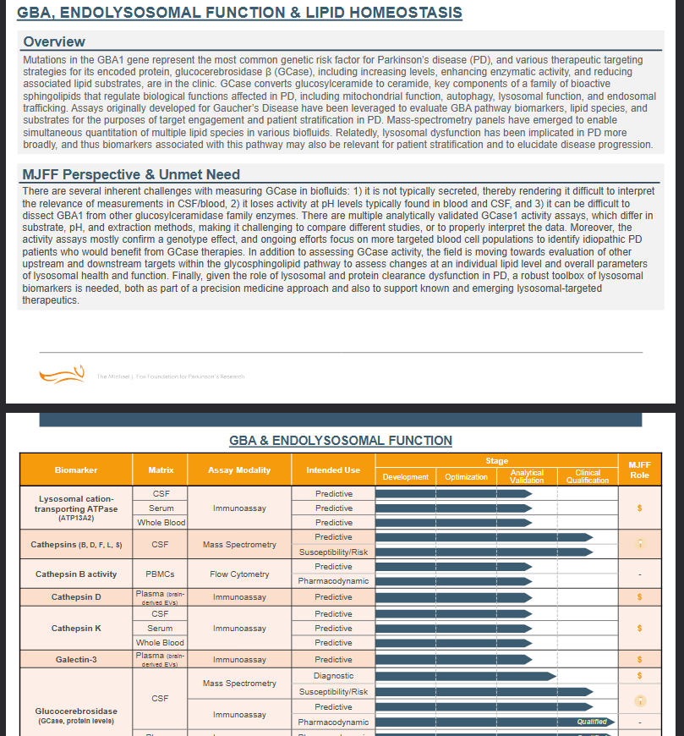
Previous biomarker reports
Notes:
Call out static nature of report & complexities in adding modalities beyond traditional targeted fluid assays- new model addresses these limitations & developing target-specific toolkits as additional resource

Slide 5
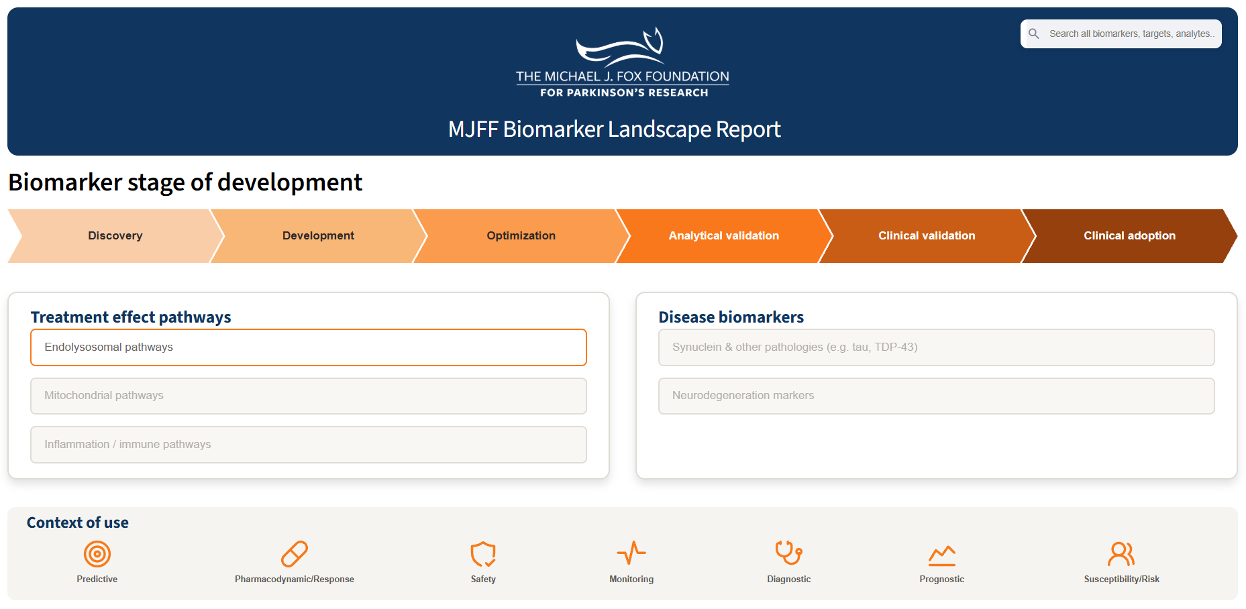
Current efforts
Notes:
Streamlit platform addresses these limitations

Slide 6
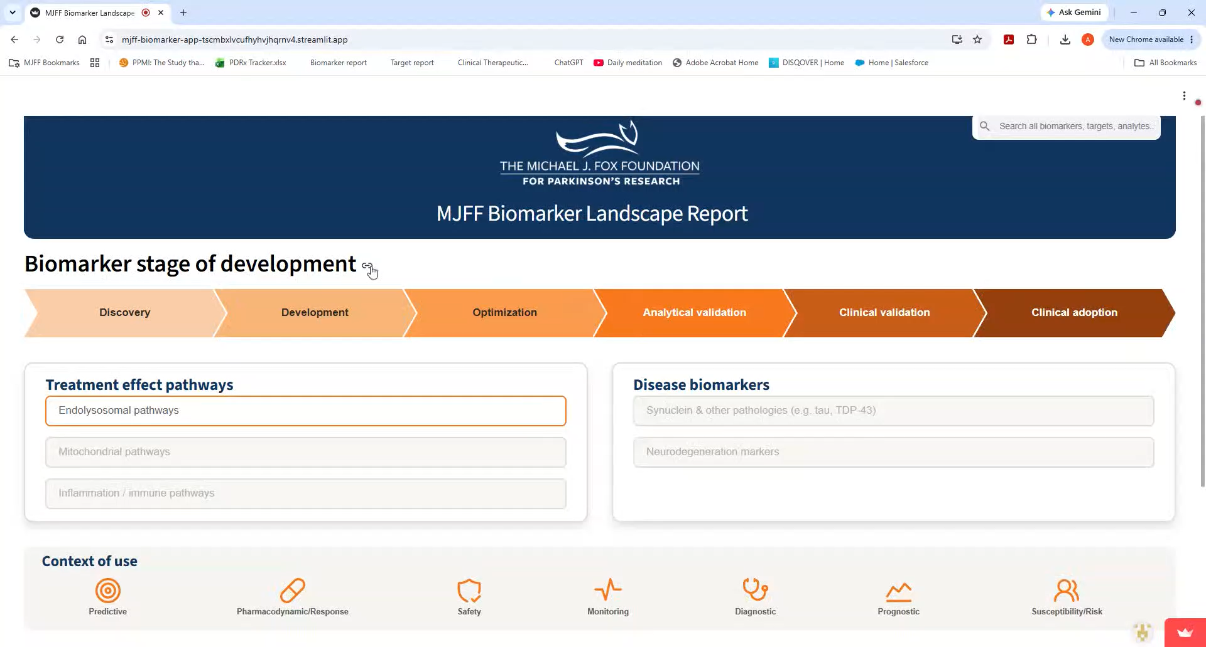
Notes:
Streamlit platform addresses these limitations

Slide 7
Our goals: advancing assays & sharing resources across the field
Engage community/industry stakeholders to inform prioritization of assay development & disseminate updated biomarker pipeline report
01
02
Develop standardized biomarker toolkits for early-phase clinical trials

Slide 8
Core NLRP3 biomarker framework
Includes clinically validated assays based on 1) readouts from early-stage NLRP3-inhibitor trials & 2) PD literature where relevant
Target/proximal pathway engagement
Downstream pathway engagement
Neurodegeneration / neuroinflammation
Exploratory
Category | Biomarker / Analyte | Matrix | Assay Platform | Recommended CoU
Proximal | IL-1β (total) | CSF, Plasma, Whole blood | Simoa, MSD S-PLEX | Pharmacodynamic
Proximal | IL-18 (total) | CSF, Plasma | MSD U-PLEX | Pharmacodynamic, likely predictive*
Proximal | ASC (total), Caspase-1 (p20 fragment) | Plasma | ELLA | Likely predictive* (pharmacodynamic not studied)
Downstream | hsCRP | Plasma | Roche Cobas | Pharmacodynamic, predictive under investigation
Downstream | Fibrinogen | Plasma | Clauss method | Pharmacodynamic, likely predictive*
Downstream | IL-6, IL-8 (CXCL8), MCP-1 (CCL2), SAA | CSF, Plasma | MSD U-PLEX | Pharmacodynamic
Downstream | TREM2 | CSF | Simoa, ELLA | Potentially pharmacodynamic#
Downstream | TSPO | Brain (imaging) | PET (18F-DPA-714) | Potentially pharmacodynamic# (mechanistic substudy recommended)
Neuro/Infl. | GFAP/NfL (2-plex), Aβ40, Aβ42, p-tau181 | CSF, Plasma | NCRAD (Vendor) | Potentially pharmacodynamic#, prognostic for future cognitive decline
Neuro/Infl. | S100B | CSF, Plasma | Simoa, Lumipulse | Potentially pharmacodynamic#, CSF likely predictive*
Neuro/Infl. | YKL-40, α-Synuclein (total & pS129) | CSF | MSD U-PLEX | Potentially pharmacodynamic#, YKL-40 prognostic for future cognitive decline
Neuro/Infl. | α-Synuclein seed amplification assay (SAA) | CSF | Amprion | Recommended for stratification
Exploratory | NULISA Neuro 220 & Inflammation (340 & AQ) panels | CSF, Plasma | Alamar (Vendor) | --
*Likely predictive indicated where literature shows upregulation of the listed biomarker in PD studies.
#Potentially pharmacodynamic indicated where inclusion in trials is recommended, but no post-treatment changes have been observed yet in short trials (28 days).
This table is current as of August 2026 and will be refined as additional assays progress through the biomarker pipeline and undergo validation.

Slide 9
Core GBA1/GCase biomarker framework
Current biomarker landscape outlining analytically validated assays for GBA1-targeting trials
Target engagement
Pathway engagement
Neurodegeneration / inflammation
Exploratory
Category | Biomarker / Analyte | Matrix | Vendor | Limitation
Target | GCase enzymatic activity | CSF, PBMC, Dry blood spot | Nextcea, Revvity, Centogene | Variable sensitivity across platforms, currently under evaluation by MJFF, reliance on artificial substrates
Target | Glucosylceramide (GluCer), Glucosylsphingosine (GluSph) | CSF, Plasma, Urine | Nextcea, Lipotype, Ardena | GluSph in CSF remains a challenge- variable endogenous concentrations across platforms
Pathway | Sphingolipids | CSF, Plasma, Urine | Nextcea, Lipotype
Pathway | Bis(monoacylglycero)phosphate (BMP species) | Plasma, Urine | Nextcea, Lipotype | Less established link to GBA1
Pathway | Lysosomal panels (Cathepsins, GPNMB, exocytosis and endosome trafficking markers) | CSF | Inoviv, Zetterberg | Relevance to GBA1 therapies under evaluation through MJFF funding
Neurodegen. | GFAP / NfL (2-plex), Aβ40, Aβ42, p-tau181 | Plasma | NCRAD
Neurodegen. | p-tau217 | Plasma | Lilly
Neurodegen. | α-Synuclein seed amplification assay (SAA) | CSF | Amprion
Exploratory | NULISA CNS-200 & Inflammation panels | CSF, Plasma | Alamar | Relevance to GBA1 therapies under evaluation through MJFF funding
Exploratory | Selected metabolites | CSF, Plasma, Urine | Metabolon | Relevance to GBA1 therapies under evaluation through MJFF funding
Exploratory | Targeted lipid panels | Plasma, Urine | Lipotype, Nextcea, Ardena | Relevance to GBA1 therapies under evaluation through MJFF funding
This table is current as of August 2026 and will be refined as additional assays progress and become validated.
Notes:
Call out Fernanda as leader of portfolio who can address additional specific pathway related ?s

Slide 10
Current Biomarker Landscape for LRRK2-Targeted Trials
Includes assays across all development stages
Target engagement
Pathway engagement
Neurodegeneration / inflammation
Exploratory
Category | Biomarker / Analyte | Matrix | Vendor | Ongoing Work
Target | Total LRRK2 and pRab10 (duplex) | CSF | Biognosys* | Validation package due Oct 2026
Target | pRab12 | CSF | Biognosys* | Single-analyte assay in development
Target | LRRK2/Rab PRM | PBMCs | Dundee currently# | Possible transition to a CRO
Target | Total LRRK2, pS1292-LRRK2, pRab10, pRab12 | CSF, Plasma, Serum | Alamar | Single-analyte assays in development for quantitative NULISAqpcr
Pathway | Bis(monoacylglycero)phosphate (BMP species) | Urine, Plasma, CSF | Nextcea, Lipotype | –
Pathway | Glucosylceramide (GluCer), Glucosylsphingosine (GluSph) | CSF, Plasma, Urine | Nextcea, Lipotype, Ardena | Panels are being evaluated as part of round-robin efforts
Pathway | Sphingolipids | CSF, Plasma, Urine | Nextcea, Lioptype | Ongoing in plasma and urine in PPMI, expansion to CSF to be discussed
Pathway | Lysosomal panels (Cathepsins, GPNMB, exocytosis and endosome trafficking markers) | CSF | Inoviv, Zetterberg | Other panels in evaluation as part of round-robin efforts
Neuro/Infl. | CD68 | CSF | TBD | Vendor selection in progress
Neuro/Infl. | GFAP/NfL 2-Plex, Aβ40, Aβ42, p-tau181 | Plasma | NCRAD | –
Neuro/Infl. | p-tau217 | Plasma | Lilly | Pending outcome of PPMI discussion
Neuro/Infl. | α-Synuclein seed amplification assay (SAA) | CSF | Amprion | –
Exploratory | NULISA CNS-200 and Inflammation panels | CSF, Plasma | Alamar | Ongoing efforts in PPMI
Exploratory | Selected metabolites | CSF, Plasma, Urine | Metabolon | Ongoing efforts in PPMI
Exploratory | Targeted lipid panels | CSF, Plasma, Urine | Lipotype | Ongoing efforts in PPMI
Exploratory | Quantitative SAA efforts (digital and EV assessments) | CSF | Knowles/others | Emerging areas for consideration
*Biognosys is developing a duplex assay of total LRRK2, pRab10 and is developing a single analyte pRab12 assay for CSF. The current deadline for a validation package is October 2026.
#These assays are currently at Dundee; may be transitioned to a CRO for trial.
Source: Guidance on LRRK2 Biofluid Biomarkers for use in LRRK2 Clinical Trials | Zenodo

Slide 11

Notes:
We plan to work on targets based on the robustness of the therapeutic pipeline for a given target

Slide 12


Decision Enabling Biomarkers for Therapeutic Development
    Early Phase POC
    (Phase 1b/2)
Phase 1b/2 biomarker studies
Target engagement & PD response
Dose selection & patient stratification
Go/no-go decision support
GOAL:
Use biomarkers as decision enabling tools across the clinical development continuum in Parkinson’s Disease
    Prospective & Retrospective Biomarker Analyses
Biomarker analyses within ongoing/retrospective trials with existing samples/datasets
Inform trial design, de-risk development
Support broader biomarker validation
Generate decision-enabling insights
Confirm Target Engagement & Clarify Mechanism Validity
Inform Patient Stratification and Responder Identification
Guide Therapeutic Development Decisions
Notes:
- Refresh on intros

Slide 13

Biomarker Innovation and Advancement Program
Program Live November 5th
    Accelerating Drug Development Tools Toward Clinical Adoption
Evaluate and quantify target engagement & disease pathology
Validate, standardize, and scale assays & tools for clinical adoption
Define context of use for drug development tools
GOAL:
Translating promising technologies and biological signals into reliable, accessible tools for defined contexts of use in PD clinical trials
    Characterizing Clinical Biomarker Signatures and Underlying Disease Biology
Integrate biomarker data with clinical, genetic, fluid, and imaging measures to identify disease signatures
Apply novel approaches and advanced analytics to map and measure disease-driving pathways
Develop, validate, and scale fit-for-purpose drug development tools
Map and measure disease-driving pathways underlying PD heterogeneity
Characterize clinical biomarker signatures
Notes:
- Refresh on intros

