Slide 1
MJFF Patient Engagement Consultancy
Learnings and Resources to Accelerate Patient-Relevant Research

Slide 2



MJFF PE Consults with a Range of Partners
Company A is weighing benefits/costs of reformulating infusion therapy to subcutaneous injection. How do patients& care partners compare these options?
Company B is looking for patient feedback on Phase 1B eligibility and trial design, including biosampling, imaging, and use of a wearable device.
Company C wants a website where potential volunteers can learn more about its new Phase III trial and raise their hand to screen.
Company D is a pre-clinical grantee looking to motivate/ inspire lab employees by hearing from people living with PD.
Notes:
What does Patient Engagement from MJFF look like? It is recruitment, that is for sure. But it’s also helping companies understand their market and its needs.
These are all requests that we’ve supported recently. We’re connecting companies with data, people and resources. We’re also helping them get to the answers they seek indirectly. What kind of patients should you ask? How may you integrate feedback from patients while maintaining scientific integrity/aims?
Caveat: these are clinical programs but they have impact on biomarkers and translational research. Will patients take a type of therapy? Will they give certain samples required for biomarker testing?
And not just companies. Talk with FDA about how to gauge meaningfulness. Talk with internal portfolio managers on how to assess patient need or review funded grants for consideration of participant experience/needs.
A: Denali BEACON (2a) LUMA 2b
B: Sanofi
C: Roche
D: AbbVie

Slide 3
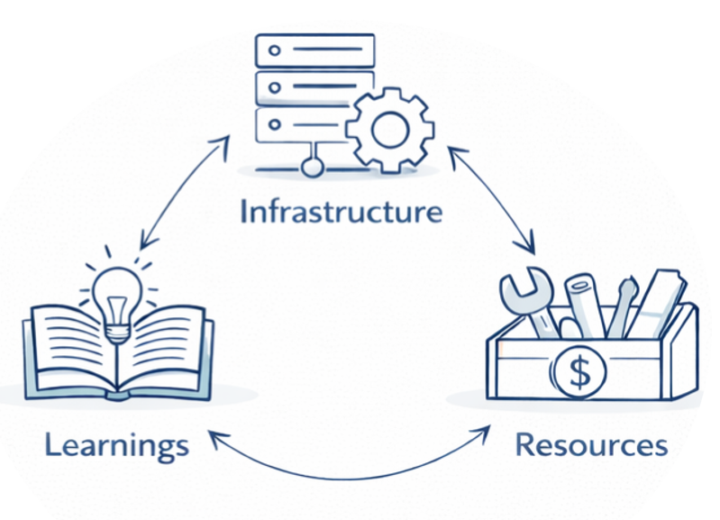

Slide 4
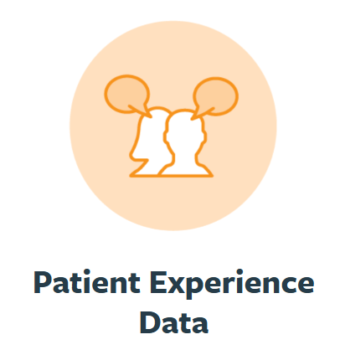
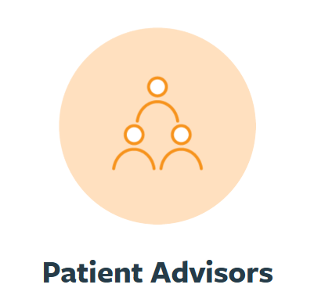
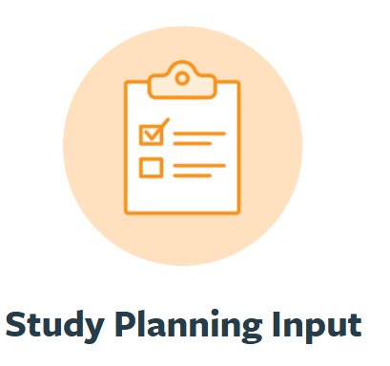
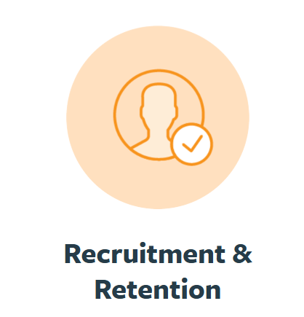
Patient Engagement Services

Slide 5

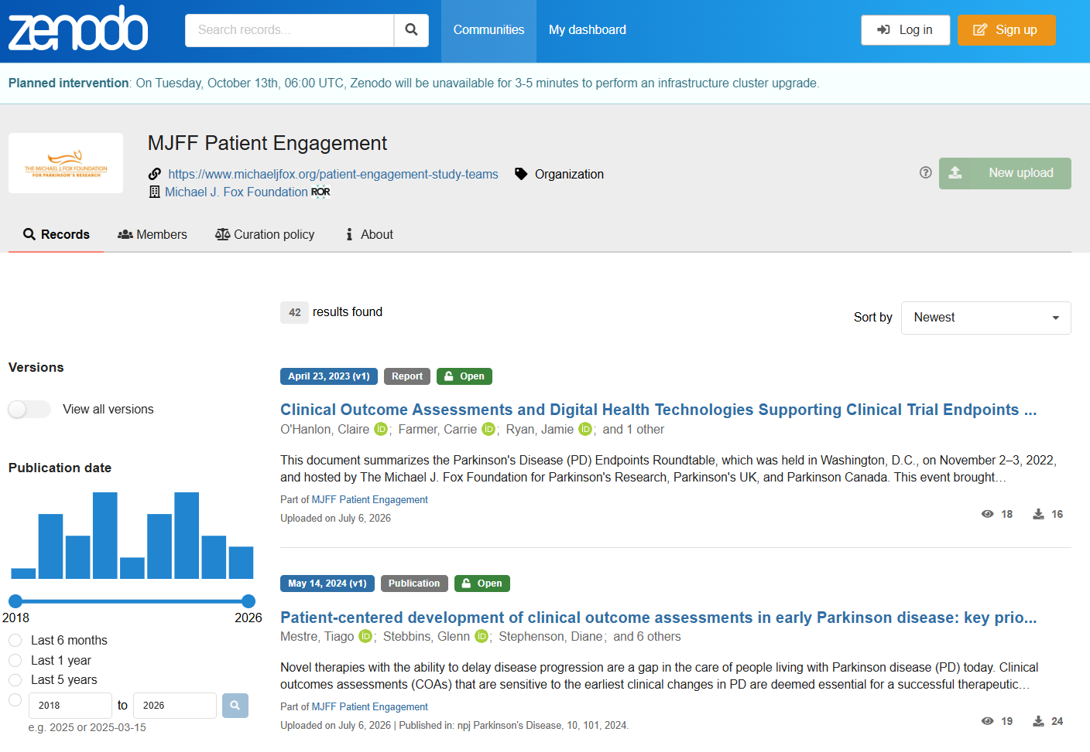
Patient Experience Data
Our analysts can (i) consult on survey questions and design and (ii) share previous relevant results.

Slide 6
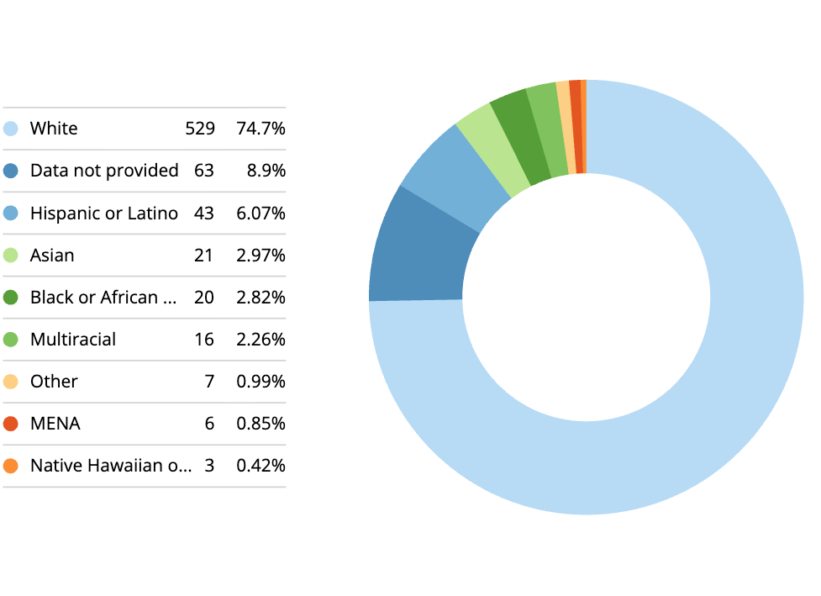
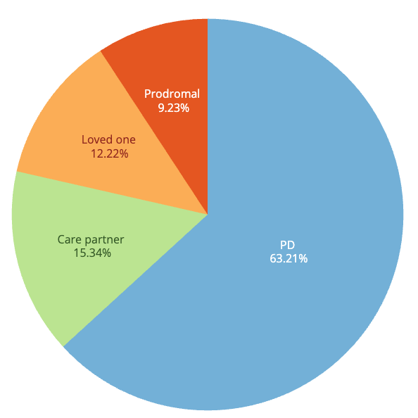
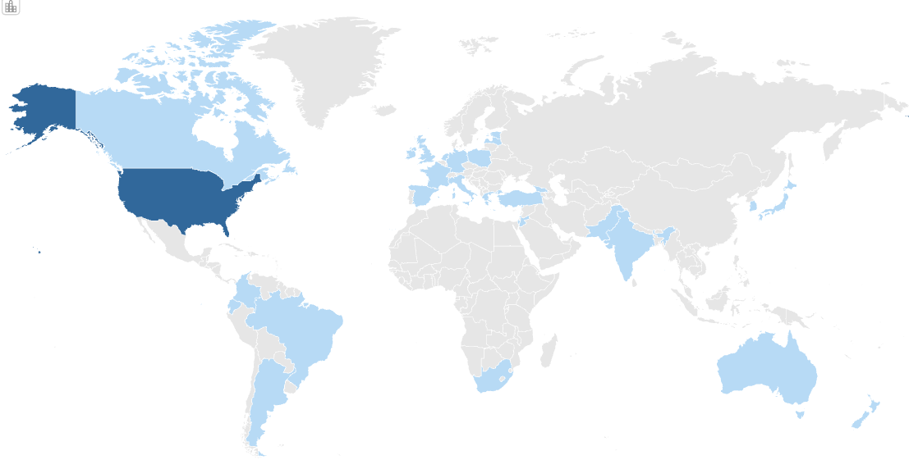
Patient Advisors
We pull from our lived experience network to match to requests and facilitate interactions.
700+ members
Demographics
Disease stage
Genetics
Clinical expertise
Research experience
Recruiting More:
LRRK2 & GBA PD
LBD/co-pathology
Prodromal
Recently dx
Notes:
The Lived Experience Network is made up of 708 PwP, care partners, loved ones, and prodromals (or those with PD risk factors).
We are building a Network that can support a wide range of research needs. Part of the appeal here is that we know a lot of details about the lived experiences of these people so we can match them to specific research asks. We know their disease stage, genetic markers they carry, what kinds of research they have experience in, and if they have any clinical expertise. That's what sets this group apart. With the rise of precision medicine in PD, it's important that we know details about these individuals to effectively match them to research engagements that they would be interested in. For instance, in this group, we have 20 LRRK2+ PwP – industry partners are becoming more and more focused on this population with the rise of precision medicine in PD.
We also need this Network to have broader representation across lived experience and background. There are 116 people of color represented in the network. 14% of participants live outside the United States
Continued growth in priority populations remains important for this group. Those populations are prodromals, LRRK2 and GBA mutations, recently diagnosed, co-pathology. As we monitor trends in PD research, we shape our strategy to find more people from those populations.
TAKE A DEEP BREATH - slow

Slide 7
Study Planning Input
We can share our experience toward accelerated recruitment and improved retention.
I/E Criteria
Site Selection
Schedule of Activities
Meaningful Outcome Measures
Compensation and Reimbursement
Recruitment and Retention Planning
ICF & Study Materials Review

Slide 8
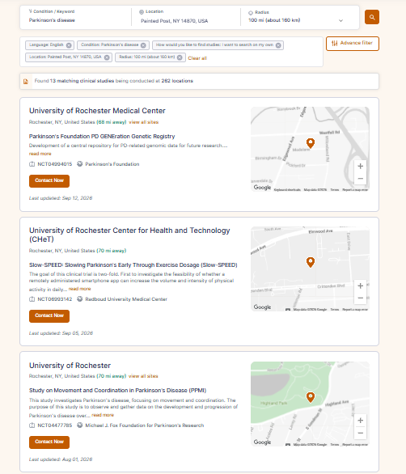

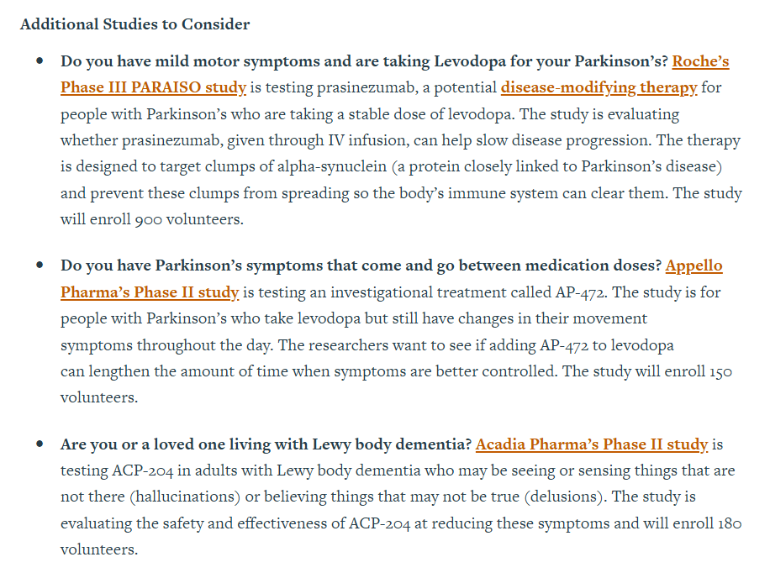
Recruitment & Retention Support
We can consult on R&R practices as well as offer direct recruitment through MJFF channels.

Slide 9
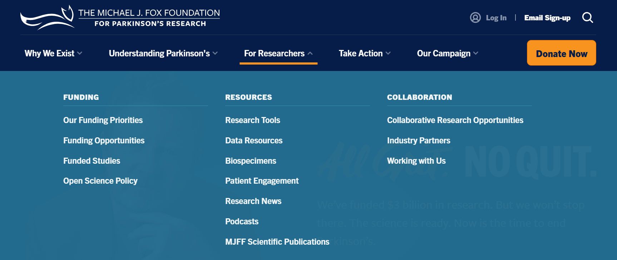
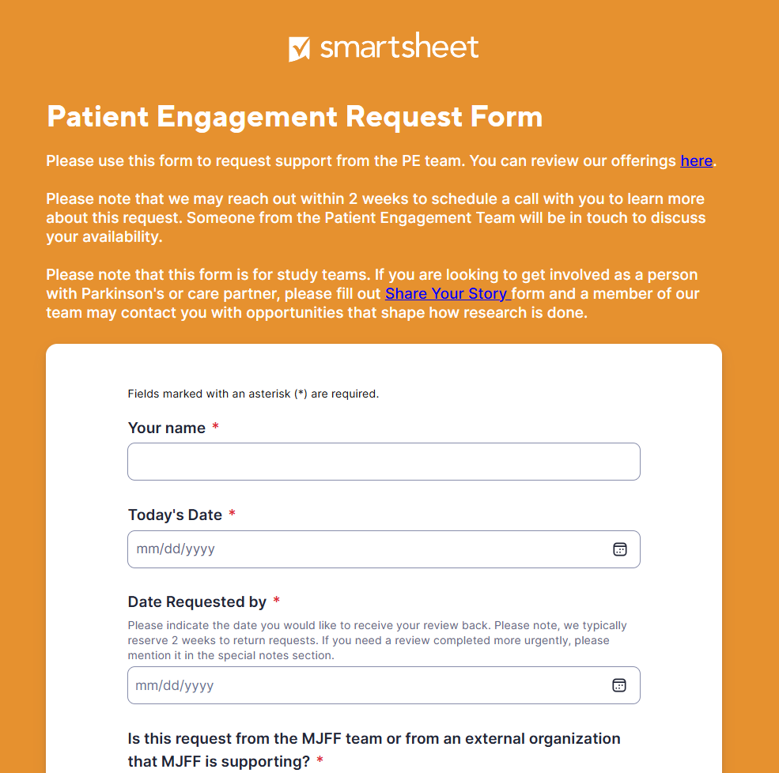

Get In Touch

Slide 10
Drive Our Strategy to Meet Your Needs
How do you currently operate re: patient engagement?
Where do you see the most value-add from our portfolio?
What are we missing?
Where do you see friction in the process of patient engagement?
Where is your science leading where we can help prepare?
How can we better measure the impact of patient engagement?

