Slide 1
MJFF Targets to Therapies
PDTC Breakout Session
October 14, 2026

Slide 2

How familiar are you with T2T?

Slide 3
For those who have heard of T2T, how have you encountered it?
T2T Publications or T2T Target Explorer
Through colleagues/collaborators/other
A T2T meeting, town hall, or direct involvement
A T2T meeting, town hall, or direct involvement
Through an MJFF funded project or collaboration
Not applicable

Slide 4
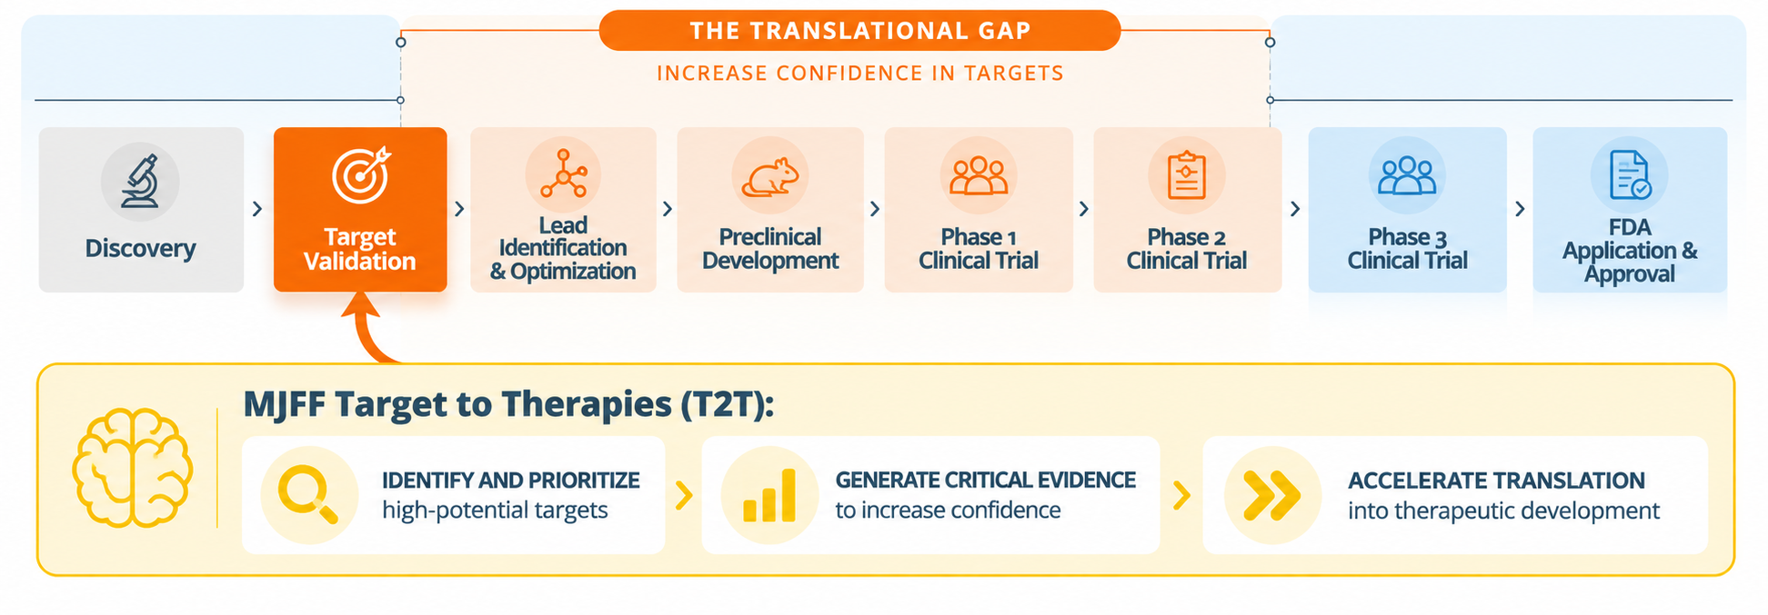
T2T: Advancing Promising Biology Towards Therapies

Slide 5
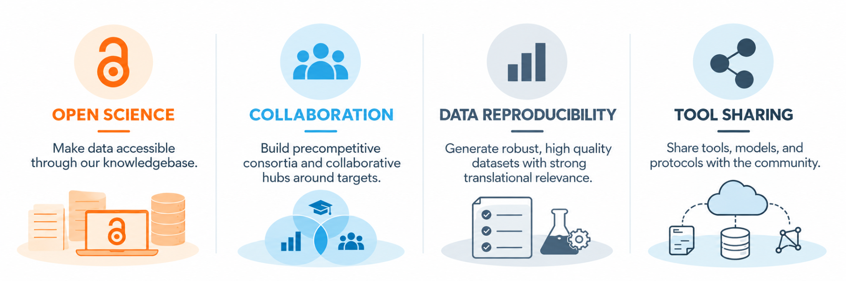
The Principles That Power MJFF Programs, Such as T2T

Slide 6

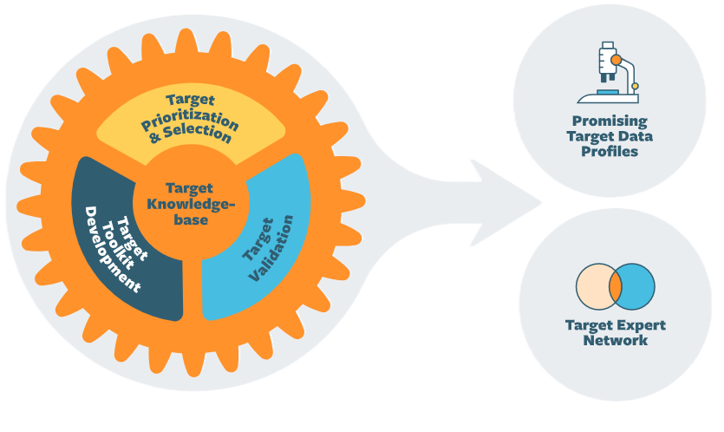
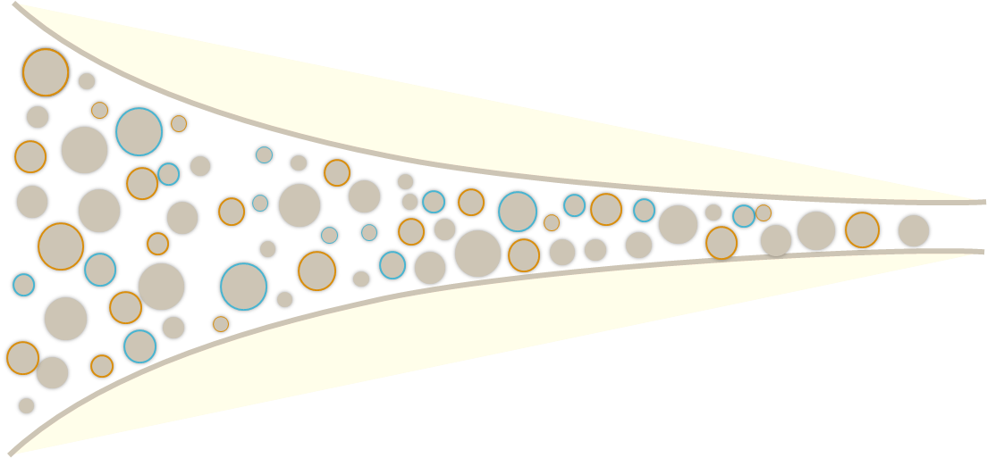




T2T’s Engine: From Targets to Impact
Advancing promising biology, with diverse mechanisms, to deliver transformative therapeutics
RICH TARGET INPUTS
T2T ENGINE
OUTPUTs
External datasets

Slide 7
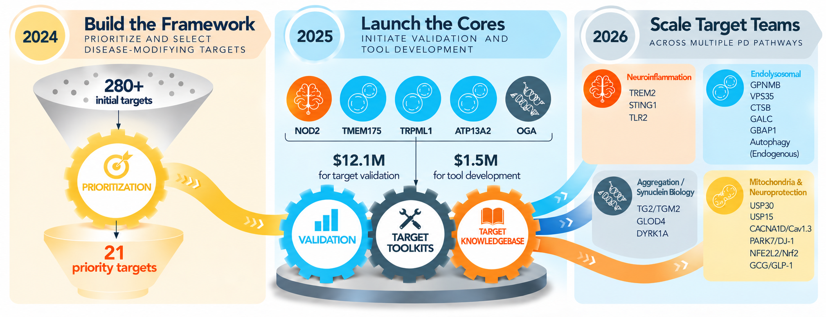
Building the T2T Engine
From target prioritization to a scalable system for target validation and therapeutic translation

Slide 8
Building the T2T Engine
From target prioritization to a scalable system for target validation and therapeutic translation

Slide 9
Building the T2T Engine
From target prioritization to a scalable system for target validation and therapeutic translation

Slide 10
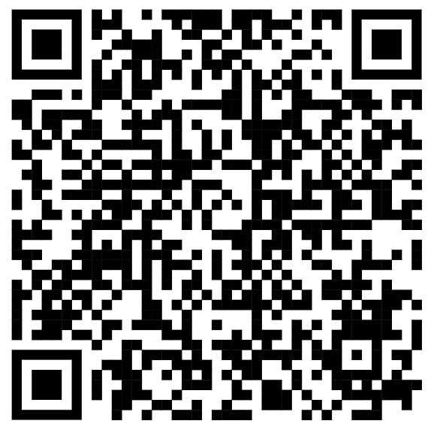
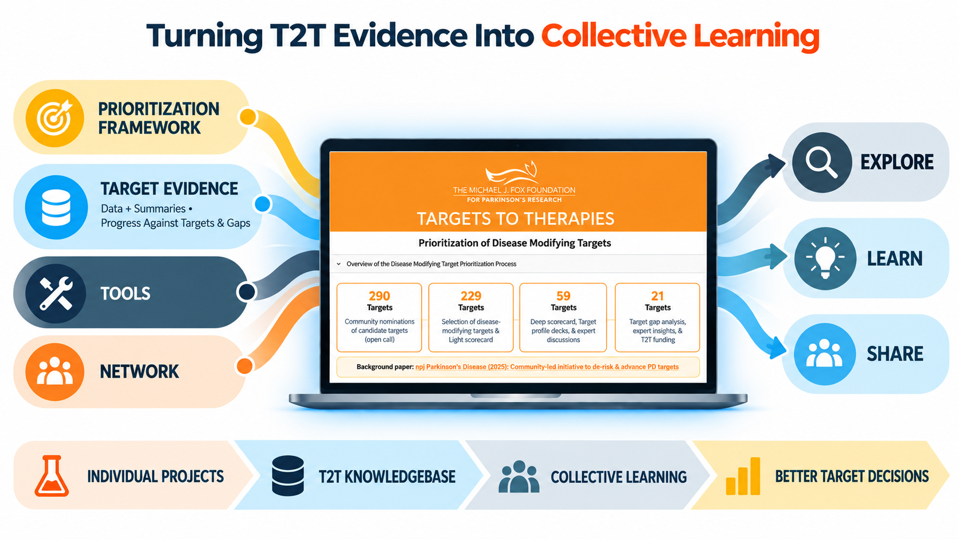
Sharing Target Profile Data to Drive the Field Forward
Notes:
This is how we’re going to get the data out to the community
QR codes for streamlit

Slide 11
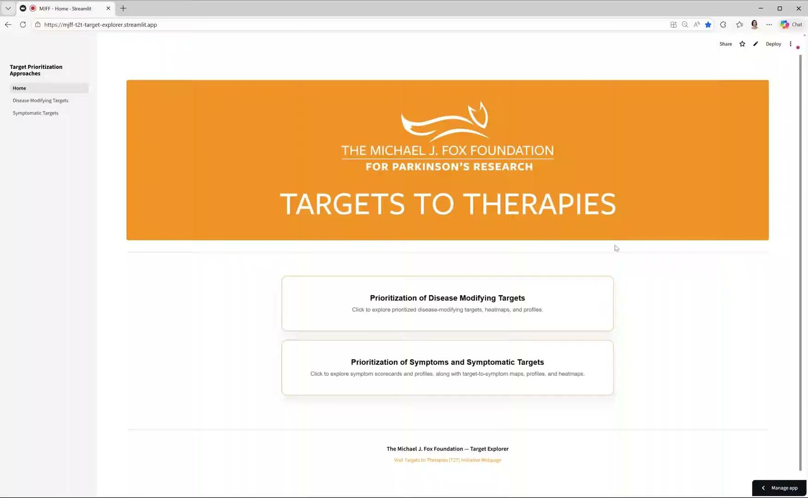

Slide 12
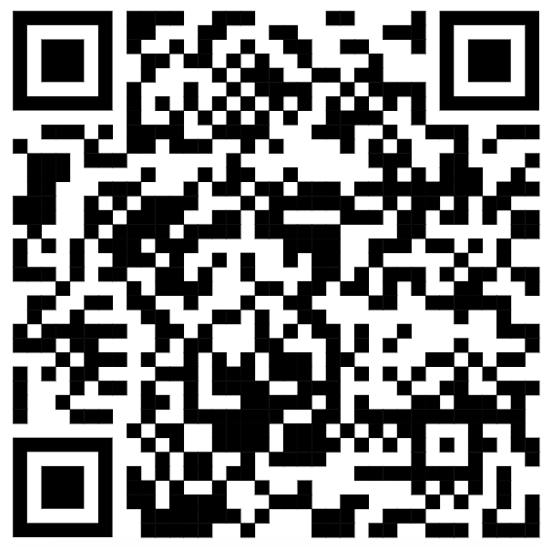
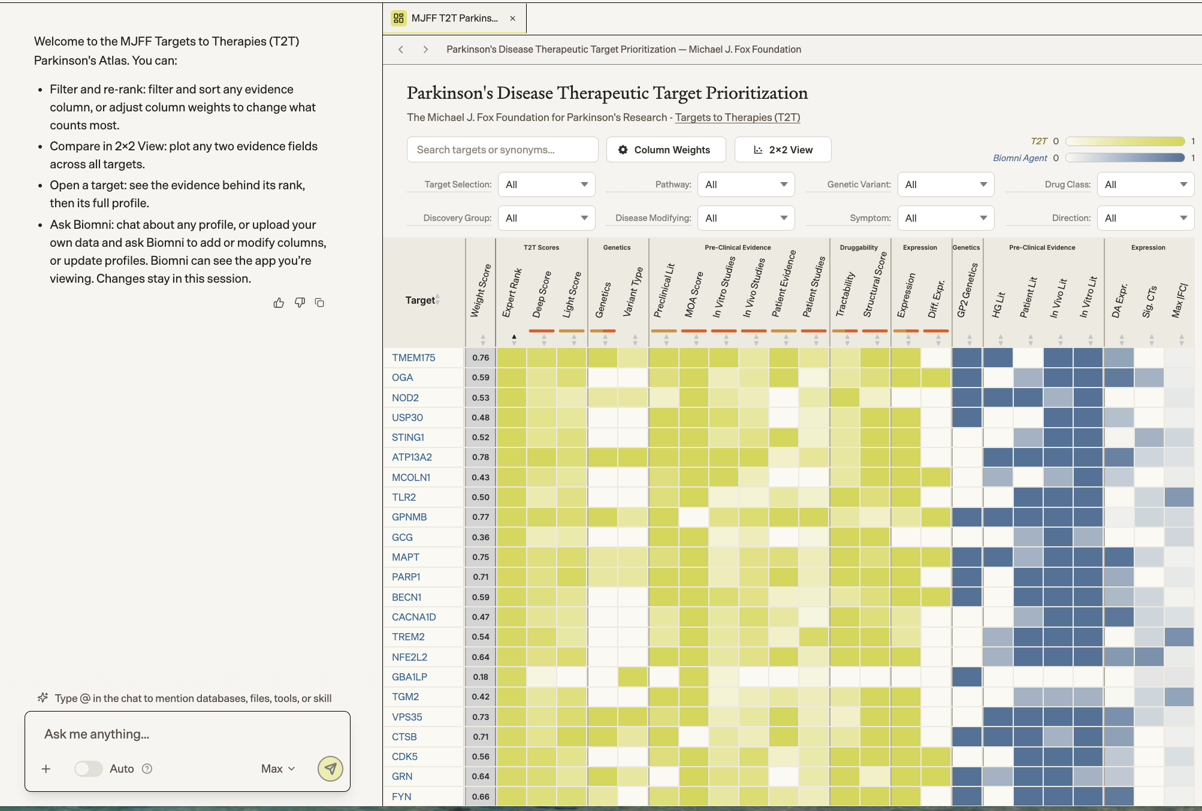
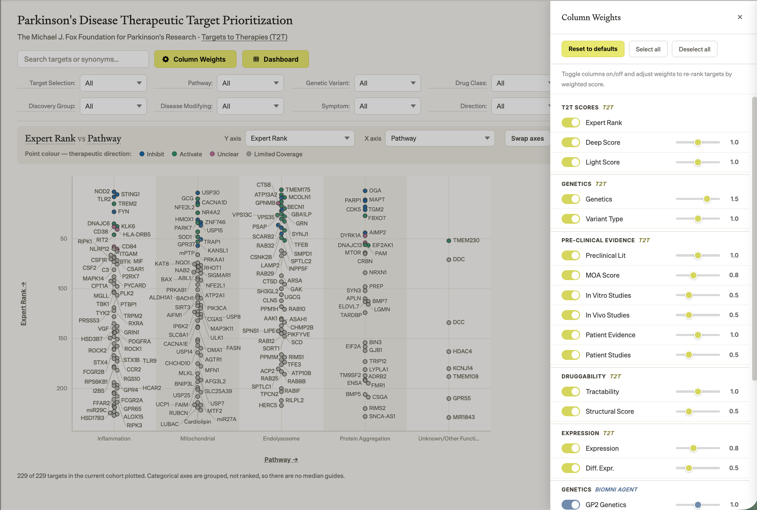
New: AI-driven Target Prioritization App

Slide 13
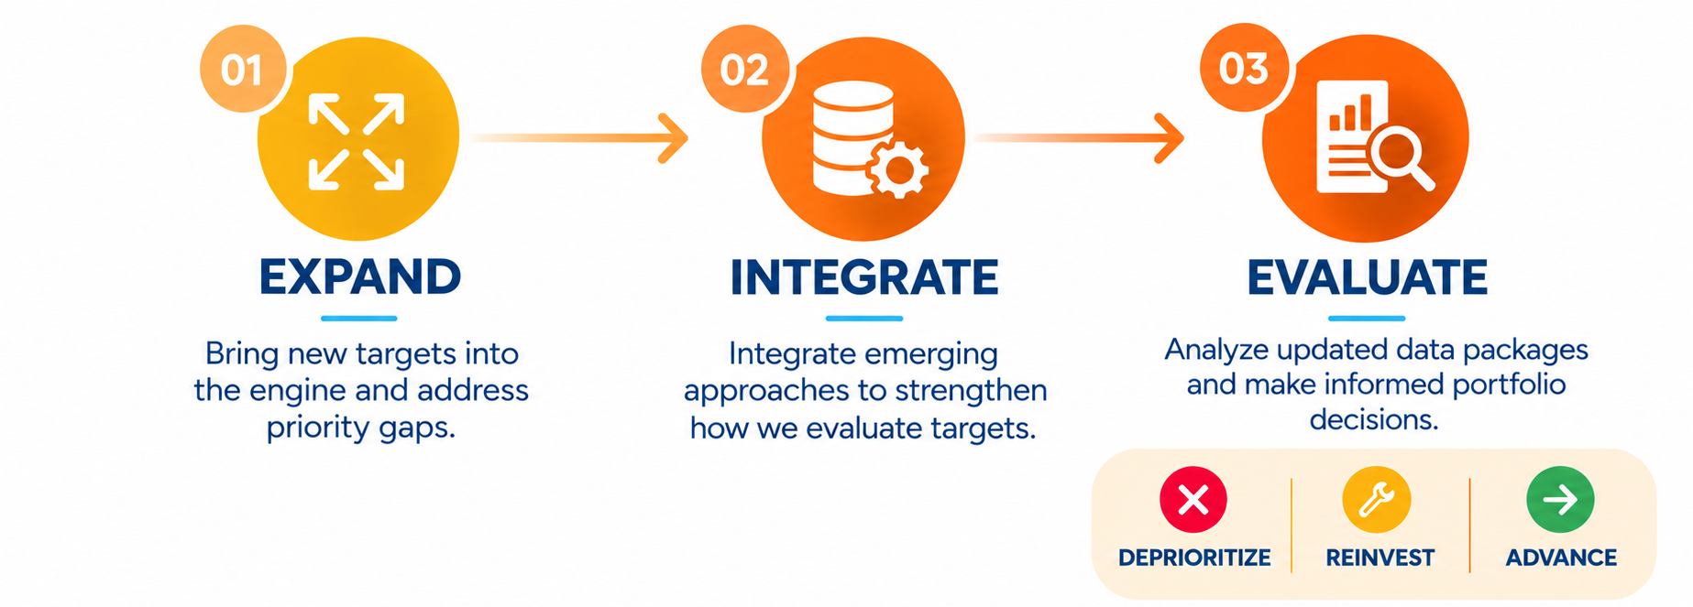
What’s Next for T2T?
T2T is a continuously learning system that expands the target pipeline, integrates emerging evidence and approaches, and enables stronger portfolio decisions.

Slide 14
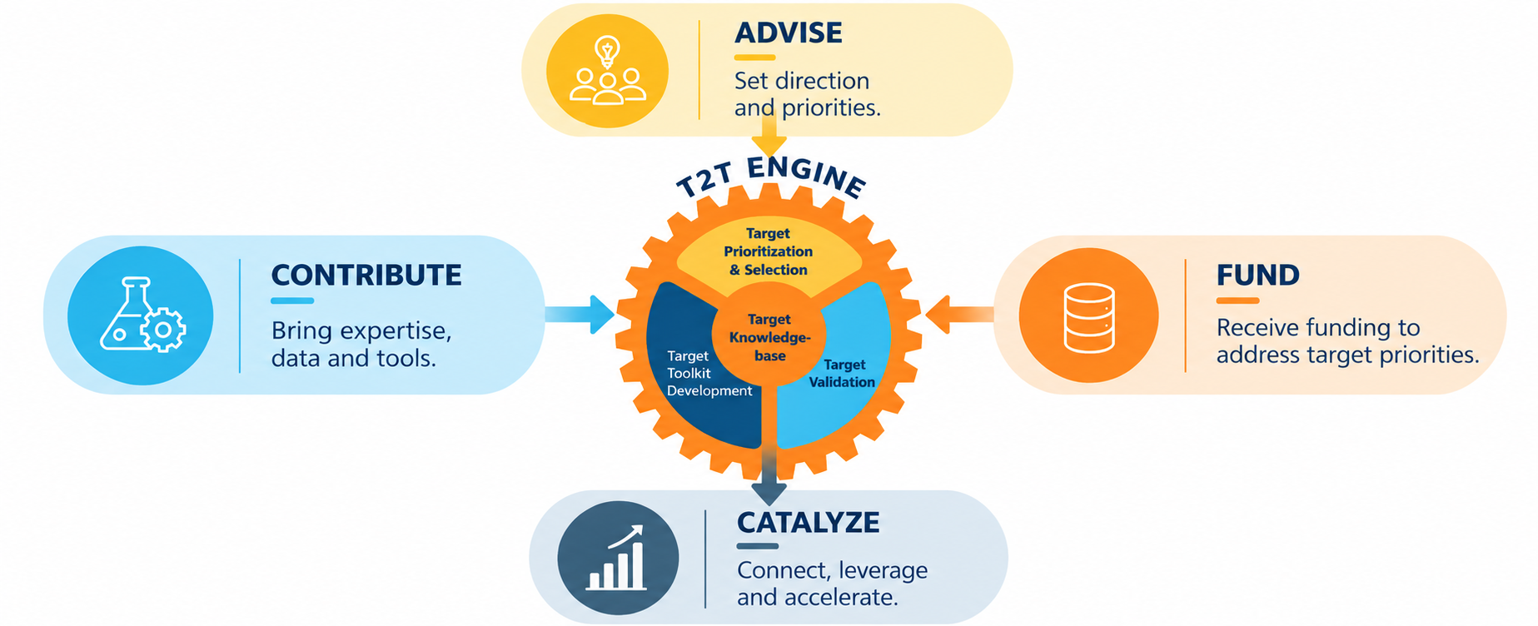
Partnering with T2T
T2T brings together data and tools, expertise, funding, and partnerships + community to move promising targets toward therapies.

Slide 15
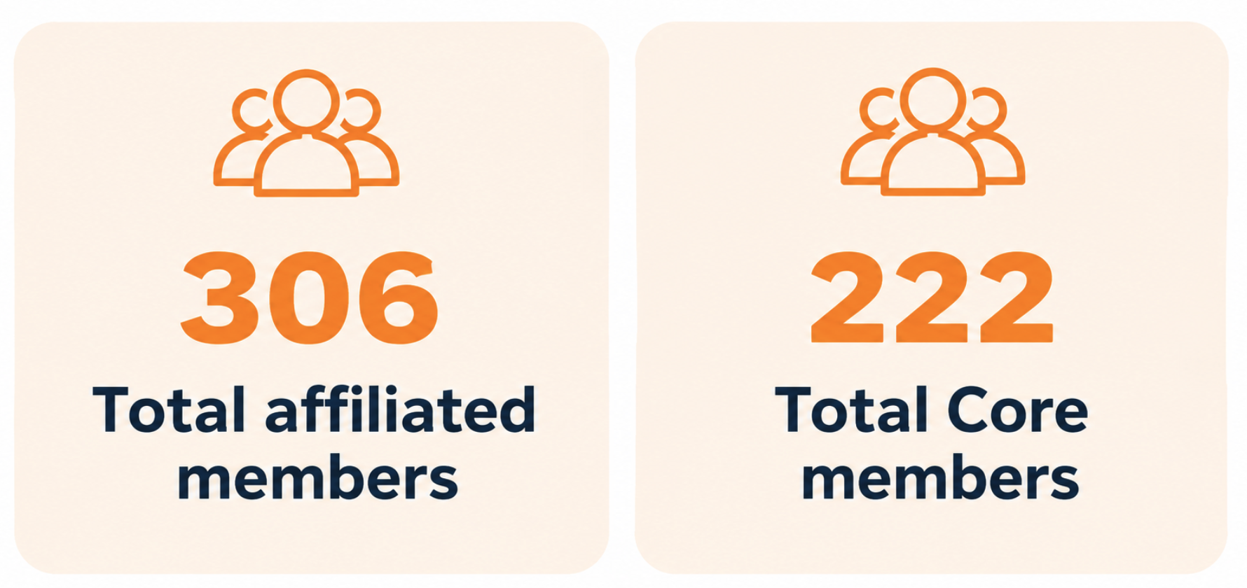































































T2T Industry & VC Network
Prioritization & Selection 2024
Prioritization & Selection 2025
OGA
Endo 1
NOD2
STING/TLR2/TREM2
Mito
Endo 2
Agg & aSyn Biology
GLP-1
NEW
NEW
NEW
NEW
CRO

Slide 16
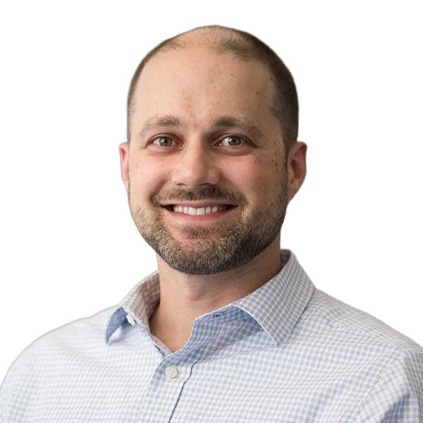
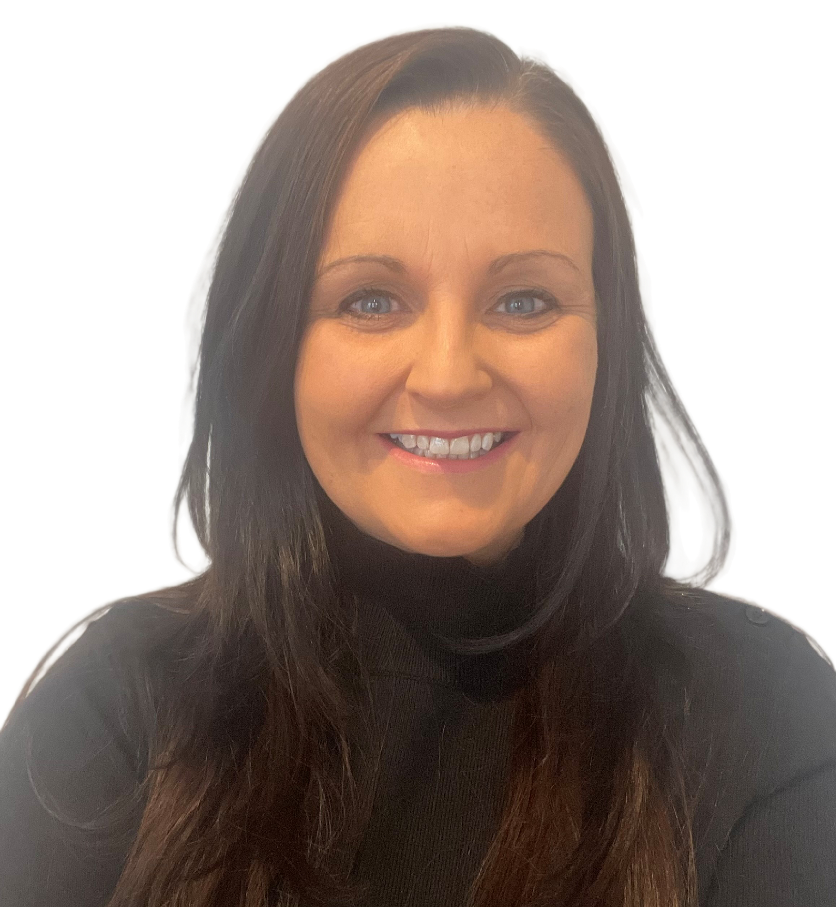
T2T: In Conversation with Our Advisors
Jon Behr, PhD
Fiona Ducotterd, PhD
Independent Director, Parkinson’s Research Ventures LTD
Independent Consultant
Independent Director, Parkinson’s Research Ventures LTD
CSO, Alzheimer’s Research UK UCL Drug Discovery Institute
President & Founder, FIreWire Consulting, LLC

Slide 17
When assessing a target, which type of evidence is most important to you?
Human genetic evidence
Evidence in PD patient samples
Preclinical evidence from cell and animal models
Clarity on the therapeutic direction and mechanism
Target druggability
Other

Slide 18
When deciding whether a target is worth pursuing, what information is most useful?
A curated list of promising targets
An integrated target profile and supporting evidence
Key knowledge gaps and risks
Available tools, assays, and models
Therapeutic landscape and competitive activity
Other

Slide 19
Even when a target looks promising, what are the biggest experimental barriers to building confidence in it?
Limited availability of validated antibodies or other reagents
Limited access to disease relevant cell models
Lack of translational animal models
Lack of robust target engagement assays
Lack of disease relevant functional readouts
Other

Slide 20
Looking ahead, where should T2T place its next level of effort?
Update the prioritized target list more often
Invest more deeply in current targets
Validate more emerging targets as the current level of depth
Assess more targets with lighter-touch approaches
Apply emerging approaches (AI, functional genomics, & human datasets)
Other

Slide 21
How would you most like to engage with T2T?
Participate in target prioritization
Advise on a target validation team
Contribute tools, compounds, models, or data
Apply for funding to aid validation of one or more targets
Use or follow T2T outputs (such as T2T knowledgebase)
Other

Slide 22
How would you prefer to receive and use T2T information?
T2T Website
T2T Target Explorer
E-mail Newsletters
Webinars or Townhalls
Other

Slide 23
Provide your email and sign up for our communications! (Write N/A if you would like to opt out)
Free Response

Slide 24
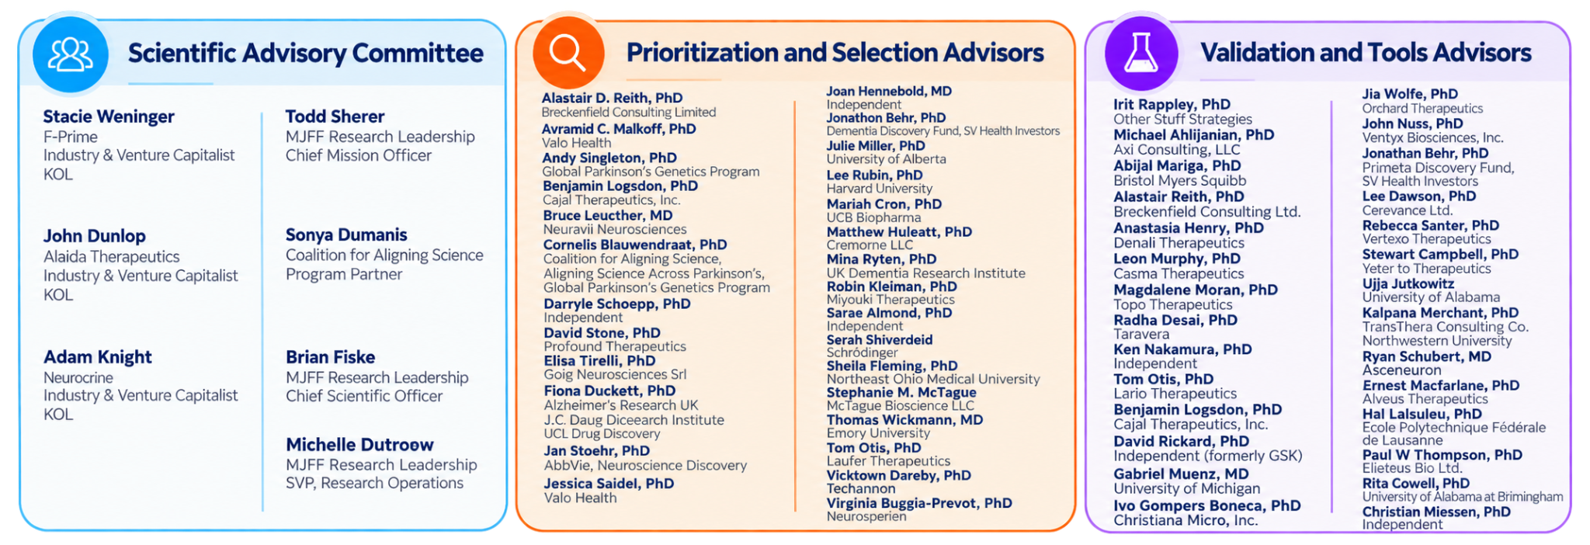
Thank you to our advisors!
Notes:
Ask Shalini about SAC - can get rid of industry and organizational partners since we have them on a separate slide

