Slide 1
Room D · MJFF Therapeutics Conference
Multimodal Data & Cohorts to Enable Precision Medicine
How advances in omics technologies, and MJFF's large-scale multimodal datasets, can inform target identification, patient stratification, biomarker strategy and clinical trial design
Kendall Jensen · Christopher D. Whelan Internal lead: Samantha Hutten
Notes:
Room D, run 3× to rotating groups (mostly preclinical industry). ~12 min of presentation shared between Kendall and Chris, then ~15 min of guided discussion.

Slide 2
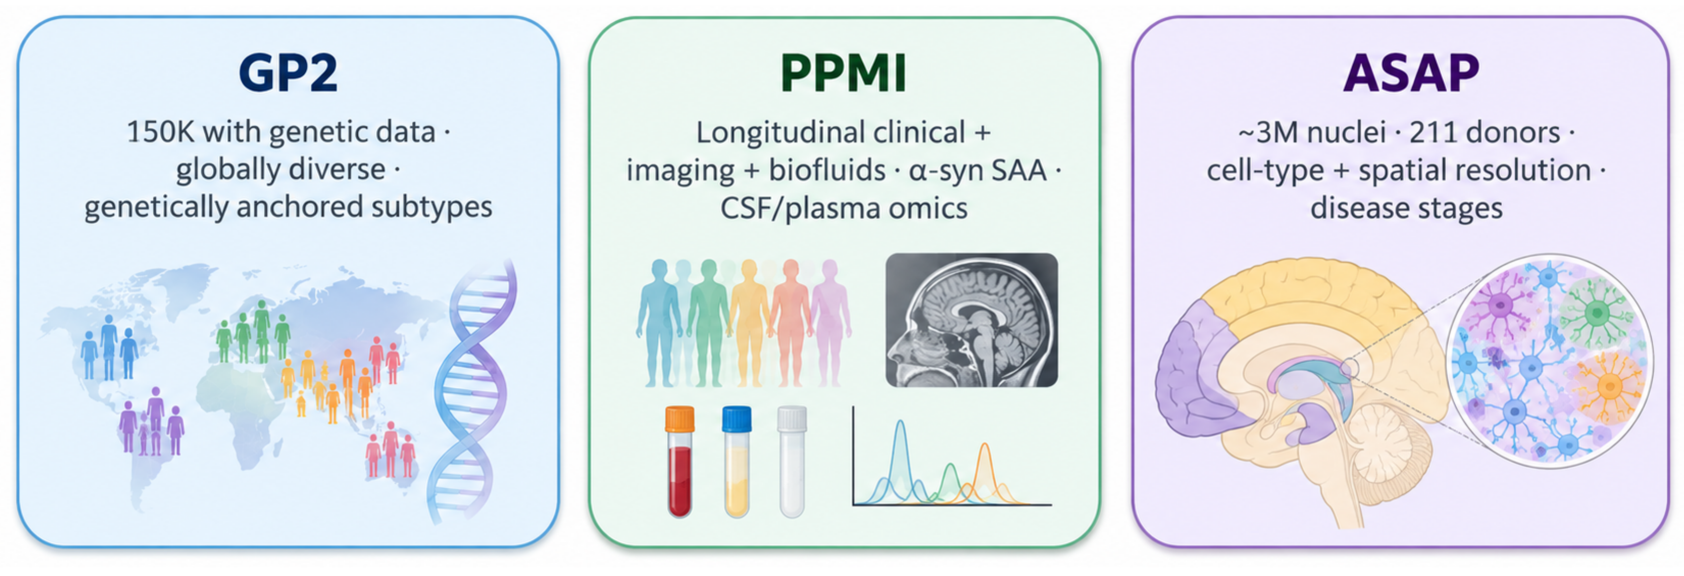
We Have Cohorts. What Should We Measure?
Large, deeply characterized human PD cohorts + rapidly expanding molecular technologies — help us decide which measurements would change therapeutic development or increase confidence in targets.
The opportunity: connect disease biology to decisions in therapeutic development.
Notes:
KENDALL — Genetics-first framing: human genetics points to candidate genes and pathways; the question is what additional evidence gives enough confidence to act.

Slide 3
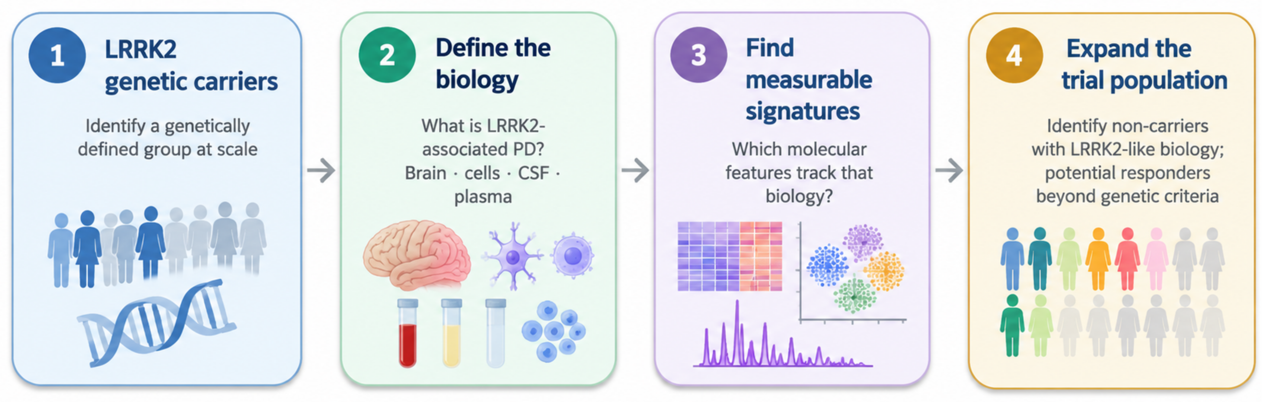
From Genetic Subtypes to Measurable Biology
Multi-omics can define LRRK2-associated biology, identify relevant cell types and pathways, and potentially extend targeted therapies beyond genetic variant carriers.
LRRK2 is one example. What biological evidence would give you greater confidence in a
therapeutic target or help identify more patients who might benefit?

Slide 4





Several multi-layer omics resources are being built for Parkinson's disease
At least four core resources -- most sponsored, implemented or co-funded by MJFF – characterized with a variety of omics tech, from genetics through single-cell and spatial profiling.
PPMI
2010–
genome
transcriptome
proteome
Metabolome/lipidome
Parkinson's Precision Medicine Initiative
Longitudinal clinical, imaging and biosample cohort: α-synuclein SAA, CSF/plasma proteomics, genetics
MJFF sponsor · industry consortium partners
Publications naming it: 2,941 since 2010 · 603 in 2025 · ~90,000 citations · 130 with pharma co-authors
GP2
2020–
genome
proteome
transcriptome
Global Parkinson's Genetics Program
>120,000 genotyped, >60,000 whole genomes, 400+ cohorts (Release 12, 2026); most ancestrally diverse PD genetics resource
Implemented by MJFF · funded by ASAP
Publications naming it: 209 since 2020 · 73 in 2025 · ~4,500 citations · 6 with pharma co-authors
AMP PD
2019–
genome
transcriptome
proteome
Accelerating Medicines Partnership — Parkinson's Disease & Related Disorders
Harmonized WGS (10,590), whole-blood RNA-seq (10,609 samples, 4,123 people), proteomics (695), post-mortem snRNA-seq
Public–private partnership (FNIH) · MJFF co-funder
Publications naming it: 225 since 2019 · 62 in 2025 · ~5,300 citations · 18 with pharma co-authors
ASAP brain atlases
2025–
transcriptome
spatial
epigenome
Allen ABC Atlas + PD5D; ASAP-funded, in the cloud
Allen ABC Atlas: ~3M nuclei, 211 donors, 9 brain regions. PD5D: snRNA-seq, Visium spatial and snATAC across Lewy-body stages
ASAP · with the Allen Institute
Publications naming it: 1,016 since 2020* · 335 in 2025 · ~30,000 citations · 38 with pharma co-authors
Sources: FNIH/AMP PD, GP2, ASAP, Allen Institute ABC Atlas, PPMI documentation (provenance_landmark_deals.md). Scales as reported by each programme; to be confirmed by MJFF.
Publications: Europe PMC titles, abstracts and open-access full text naming each resource, to end-2025 (mentions, not verified data use). Citations: Europe PMC. Pharma co-authors: ≥1 author at one of 30 pharma/biotech companies. *ASAP counts are mostly ASAP-funded research. For scale, ADNI (Alzheimer's): 11,513 papers; 1,711 in 2025.
Notes:
KENDALL / SAMANTHA — The PD resources MJFF has built or supported: PPMI, GP2, AMP PD, ASAP atlases. Productivity: PPMI is the most-used — ~2,900 papers name it (603 in 2025, up 2.5× since 2020; ~90,000 citations), about a quarter of ADNI's output, the closest Alzheimer's equivalent. GP2 and AMP PD are younger (~60–75 papers a year each and rising); ASAP is named in ~1,000 papers, mostly research it funds. Counts are papers naming each resource (Europe PMC), not verified data use.

Slide 5
Ensure alignment with changes made to previous slide
Each of these resources differ in their coverage by molecular layer
Genetics and blood transcriptomics are deep; proteomics is strong in PPMI but modest in absolute numbers; metabolomics, epigenomics and cell-resolved data are thin.
Genome
Epigenome
Transcriptome
Proteome
Metabolome
Single-cell / spatial
PPMI
some
genotyping + WGS
limited
some
blood RNA
strong
CSF/plasma proteomics
some
CSF/plasma
limited
GP2
strong
>120k genotyped · >60k WGS
AMP PD
strong
WGS 10,590
limited
strong
RNA-seq 10,609
some
proteomics 695
some
snRNA-seq
ASAP atlases
some
genotypes
some
snATAC
strong
~3M nuclei
strong
snRNA-seq + Visium
Coverage:
strong
some
limited
none
What these data can support in drug R&D
1. Target identification & validation
GP2 multi-ancestry genetics with ASAP cell-type atlases: cell-type-resolved PD targets
2. Patient stratification
PPMI and GP2 genetic and biomarker subgroups; prodromal enrichment
3. Biomarker strategy
PPMI α-synuclein SAA, CSF/plasma proteomics and longitudinal sampling
4. Trial design
Longitudinal, harmonized multimodal data across disease stages
Coverage levels are a qualitative summary of public documentation (mjff_dataset_coverage_verified.csv) and should be confirmed by MJFF before presenting.
Notes:
KENDALL / SAMANTHA — Coverage by molecular layer and the gaps. Hands to Chris: what can be measured in these cohorts, and how is industry using omics?

Slide 6
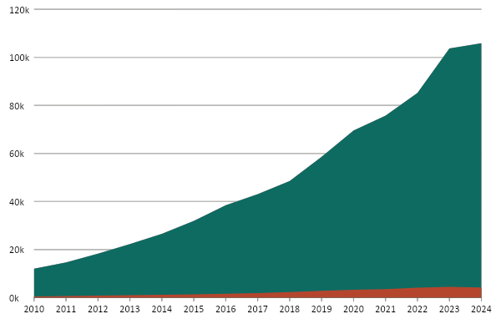
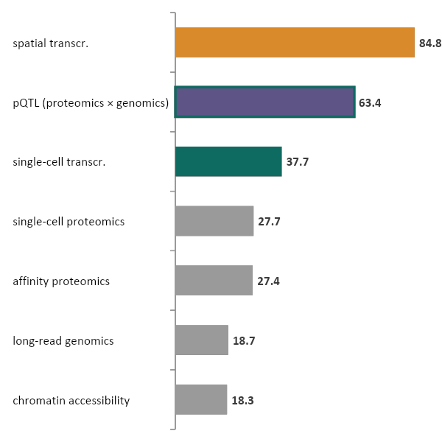
Omics publications grew ~9-fold since 2010, and even faster in Parkinson's
16 omics categories: ~6× faster than research output overall. Company-affiliated papers grew 8.2-fold, holding at ~4–5% of the total.
Publication counts understate industry activity, much of which is never published.
Publications per year (thousands)
Fastest-growing categories: annual growth, 2020–2024
8.8×
since 2010
All omics: ~106k (2024)
Company-affiliated: ~4.2k (2024)
For Parkinson's: omics papers grew ~25-fold over the same period, faster than omics overall (~11-fold in the same Europe PMC query), though from a small base.
Left: OpenAlex title/abstract queries; 2025 omitted because OpenAlex's whole corpus jumped ~35% that year. Company-affiliated = ≥1 author at a for-profit institution, including tool vendors and service labs; the share fell to 4.0% in 2024. Right: Europe PMC (MEDLINE), same terms; categories with ≥20 papers in 2020.
pQTL (proteomics × genomics, purple bar) is a cross-layer application, not a measurement modality; it and single-cell proteomics grow from small bases (23 and 32 papers in 2020). Scope excludes CRISPR screens, cfDNA liquid biopsy and immune repertoire (slide 5).
Notes:
CHRIS (~1 min) — Kendall asked what we should measure in these cohorts. The tools for measuring have scaled: omics publications up ~9-fold from 2010 to 2024 (8.8×), about 6× faster than research output overall. Company-affiliated papers (including vendors and service labs) grew 8.2-fold and stayed at ~4–5% of the total. In Parkinson's the curve is steeper: ~25-fold (Europe PMC, same terms), from a small base. Fastest-growing categories, 2020–24: spatial ~85%/yr, pQTL ~63%/yr, single-cell RNA ~38%/yr, affinity proteomics ~27%/yr. 2025 omitted because OpenAlex's whole corpus jumped ~35% that year.

Slide 7
Bulk RNA-seq is standard in pharma. The growth is in single-cell, spatial and proteomics
Share of pharma-authored omics papers, 2019→2024: bulk RNA-seq 39%→32%; proteomics 12%→17%; single-cell and spatial RNA 10%→20%.
Where it is used in R&D (shaded: biomarker and clinical use)
Pharma adoption (1–5)
Companies (of 20)
with ≥20 papers, 2020–25
Category (16) · example platforms (52)
Target ID
& validation
Hit / lead
Preclinical
MoA / tox
Translational
/ biomarker
Clinical strat.
/ CDx
today
in 5 years
range
bulk transcriptomics Illumina RNA-seq
19
single-cell transcriptomics 10x Chromium · Parse
18
MS proteomics Seer★ · Biognosys★ · DIA · TMT
11
metabolomics Metabolon · Nightingale
11
WGS/WES genomics Illumina NovaSeq X
10
DNA methylation Illumina EPIC · WGBS
6
lipidomics LC-MS · Lipidyzer
6
affinity proteomics Olink★ SomaSeq★ NULISA★ Nomic★
5
spatial transcriptomics Xenium · Visium · CosMx
3
chromatin accessibility ATAC · CUT&RUN
2
long-read genomics PacBio Revio · ONT
1
metagenomics Shotgun · 16S
1
genotyping array Illumina Infinium
0
glycomics LC-MS glyco
0
single-cell proteomics SCoPE2 · plexDIA
0
single-molecule proteomics Quantum-Si
0
1
2
3
4
5
genome
epigenome
transcriptome
proteome
metabolome
dot size = platforms per stage
For Parkinson's: Open PD resources already span most of these layers (GP2, AMP PD, PPMI, ASAP; slides 4–5). Spatial and single-cell methods need brain tissue, which only post-mortem PD resources provide.
★ Assessed in the Atlas of Proteomic Technologies (aptatlas.org). Scope: technologies that measure a molecular layer; excluded CRISPR screens, cfDNA liquid biopsy and immune repertoire. Adoption today = 5 if ≥15 of the 20 companies have ≥20 papers (OpenAlex, 2020–25; subsidiaries matched, deCODE excluded from Amgen); 4 if 8–14; 3 if 3–7; 2 if ≥3 have ≥5 papers; else 1. Range: ≥10 or ≥30-paper thresholds,
size-normalised counts, expanded queries. Publications are a lower bound on use. Companies: Roche, Merck & Co, J&J, Pfizer, AstraZeneca, Novartis, BMS, Lilly, AbbVie, Sanofi, GSK, Novo Nordisk, Amgen, Gilead, Boehringer Ingelheim, Bayer, Takeda, Regeneron, Vertex, Biogen. Commercial evidence per category: adoption_evidence_by_category.csv.
Notes:
CHRIS (~2.5 min) — One map of the toolkit: 52 platforms in 16 categories, where each is used in R&D (shaded: the translational/biomarker and clinical-stratification uses, where cohorts like PPMI matter most) and how widely pharma has adopted it. Starred proteomics platforms are the six assessed in the Atlas of Proteomic Technologies (Olink Explore HT, Illumina SomaSeq, Alamar NULISA, Nomic nELISA/Omni, Seer Proteograph XT, Biognosys TrueDiscovery). Adoption today is a reproducible count, not opinion: how many of 20 large R&D-based pharma/biotech companies have ≥20 papers (2020–25) with each technology; the grey band shows how the rating moves under other reasonable methods; no manual adjustments. The 5-year projection is my judgement. The point: bulk RNA-seq is saturated — 19 of 20 companies, adoption can't rise further, and its share of these companies' omics papers fell from 39% to 32% (2019→24). The growth is in single-cell and spatial RNA (10% → 20%) and proteomics (12% → 17%). Talk to three rows only: bulk and single-cell RNA at the top (standard), the proteomics rows (MS 4 → 5, affinity 3 → 4, with UKB-PPP, SG100K and Regeneron data arriving 2026–27), and the emerging bottom rows. Then the PD line.
LIKELY Q: 'My MS group runs thousands of samples a year and publishes almost none. Why believe a 4 for MS or a 3 for spatial?' A: Fair; it's a lower bound on visible activity, not a usage survey. We used it because it's reproducible across 20 companies; at a 10-paper threshold MS proteomics is a 5. Where you think it's wrong is exactly what we want from this room.
LIKELY Q: 'Has any omics layer beyond genetics been shown to improve probability of success, especially in PD?' A: The strongest evidence is still genetics (~2.6× relative success; Minikel et al. 2024). For single-cell and proteomics it's suggestive, not settled. In PD, molecular measurements have changed decisions mainly as targeted biomarkers (LRRK2 pathway readouts, α-syn SAA enrichment) — which argues for building omics on genetically and clinically anchored cohorts like PPMI.
LIKELY Q: 'Why exclude CRISPR screens?' A: They perturb rather than measure; we kept to measurement technologies.
LIKELY Q: 'So is proteomics replacing RNA-seq?' A: Not replacing, adding. Pharma's proteomics papers more than doubled (51 → 118) but bulk RNA-seq still grew (170 → 226) and remains the largest single category. The shift within RNA, from bulk to single-cell and spatial, is as large as the shift toward proteomics.
(Share data: Europe PMC, papers with an author affiliated to one of the 20 companies, 2019 vs 2024; affiliation matching is approximate and counts are modest: 432 → 715 papers.)

Slide 8

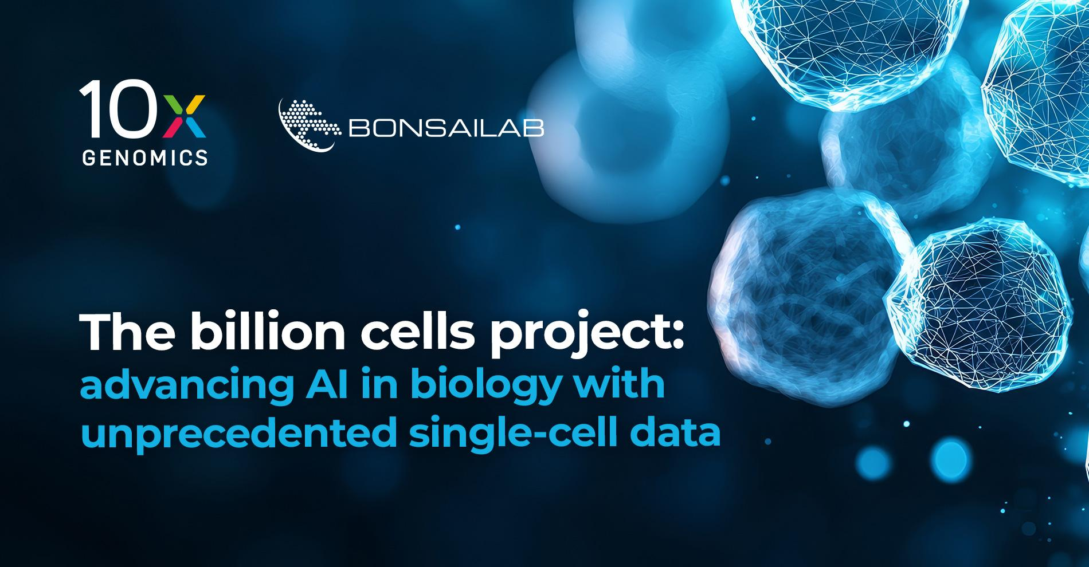
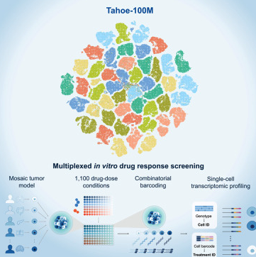








Recent omics pharma partnerships are pairing population-scale data with machine learning
Selected initiatives and partnerships, 2022–2026; figures as announced.
UKB-PPP Phase 2
2025
CZI Billion Cells Project
2025
Tahoe-100M
2025
600k plasma samples × 5,400+ proteins
1 billion single cells
100M cells · 50 cancer cell lines × 379 drugs
14 biopharma partners; population-scale plasma proteomics
With 10x Genomics and Ultima; data to train cell-level AI models
Open single-cell perturbation atlas; ~1,100 drug-dose conditions
Human Cell Atlas
2024
NVIDIA × Illumina
2025
GNPC
2025
62M cells · 9,000 donors
DRAGEN + BioNeMo
31,083 samples · 18,645 people
First-draft reference maps of human cell types
Accelerated computing for multiomic analysis
AD, PD, ALS, FTD: plasma, serum and CSF proteomics (mostly SomaScan); public July 2025
PRECISE-SG100K pharma consortium
2025–26
Recursion × Helix
2024
Our Future Health (UK)
2022–
100,000 multi-ancestry participants
Exome + clinical data at population scale
Up to 5M participants
Alnylam, Bayer, Boehringer Ingelheim, Novo Nordisk, GSK; pre-competitive access
Licensed data to train causal-inference models
Industry-partnered cohort for prevention and drug R&D
For Parkinson's: GNPC is the only neuro-specific initiative here. PD's own cohorts (slides 4–5) are smaller, but deeply phenotyped and longitudinal.
genome
transcriptome
proteome
multi-omic / computing
Curated from company, consortium and SEC announcements; see provenance_landmark_deals.md. Figures are as announced (targets, not necessarily data generated to date).
Notes:
CHRIS (~1 min) — Selected recent initiatives: population-scale data generation, often paired with machine-learning model training. Only GNPC is neuro-specific. PD's own cohorts, which Kendall and Samantha just showed, are smaller but deeply phenotyped and longitudinal; the question is what to measure in them, for targets and for biomarkers. Next: proteomics, the clearest example.

Slide 9













Population proteomics is growing rapidly, but for PD, biomarkers must replicate in CSF & across platforms
Funded cohorts are >10× larger than the largest measured to date. Affinity platforms lead on scale; mass spectrometry is now entering at cohort scale.
12 of 20
Samples with large-panel proteomics, by cohort
deCODE, Iceland
SomaScan v4 · Icelandic population
36k
large pharma/biotech companies fund current UK Biobank proteomics programmes (13 including the 2020 pilot)
UKB-PPP pilot
Olink Explore 3072 · UK, mostly European ancestry
54k
UKB-PPP Phase 2 and Illumina pilot partner lists, Jan 2025
GNPC
Mostly SomaScan – Olink, Alamar soon · AD, PD, ALS, FTD · plasma, serum, CSF
3 platforms
31k
coming soon
UK Biobank × Illumina pilot
Illumina SomaSeq Discovery · ~9,000 proteins
50k
on PPMI CSF from overlapping participants: SomaScan (1,020 samples), Olink Explore (549), mass spectrometry (1,811)
PRECISE-SG100K, Singapore
SomaScan 11K · multi-ethnic Asian
100k
PPMI data via AMP PD; multi-platform analysis, medRxiv 2025
SG100K MS layer
Seer Proteograph + Orbitrap Astral, with Olink Reveal
10k
14,287
Regeneron × Geisinger
Olink Explore HT · US health system
~200k
primary pQTLs for 2,923 proteins in the UKB-PPP pilot, 81% new
UKB-PPP Phase 2
Olink Explore HT · 5,400+ proteins
600k
300k: 14 biopharma · 300k: UK government (£20M) · data from 2026
Sun et al., Nature 2023
measured
funded / in progress
affinity
mass spectrometry
neuro-focused
For Parkinson’s disease, plasma and CSF proteomics tell different stories
Most proteins don't track between the two fluids
In paired CSF and plasma from 2,171 people, most CSF–plasma correlations were weak, and brain-derived proteins correlated least (Farinas et al., Nat Med 2025).
PD's strongest molecular markers are measured in CSF
α-syn SAA: 87.7% sensitive for PD in PPMI CSF. DDC rises in CSF on Olink, SomaScan and MS; in plasma the effect is smaller (Rutledge et al. 2024).
So: which fluid for which question?
Plasma: genetics-anchored targets, pre-diagnostic risk (~750 later-PD cases in UK Biobank). CSF: brain biology, target engagement; PPMI's longitudinal prodromal CSF.
Disclosure: Chris Whelan was named UKB-PPP lead (J&J) in the January 2025 Phase 2 announcement. Sources: UK Biobank and GenomeWeb (Phase 2 funding); Illumina (Jan 2025); Regeneron Genetics Center / Thermo Fisher (2025); Standard BioTools (SG100K SomaScan, Aug 2025); Seer and PRECISE (Apr 2026); Imam et al., Nat Med 2025 (GNPC);
Eldjarn et al. 2023; Sun et al. 2023; Farinas et al., Nat Med 2025; Siderowf et al., Lancet Neurol 2023; Rutledge et al., Acta Neuropathol 2024; EPIC4PD (medRxiv 2025.07.30.25332433). Platform comparisons: Atlas of Proteomic Technologies (aptatlas.org). SG100K pharma consortium: Alnylam, Bayer, Boehringer Ingelheim, GSK, Novo Nordisk.
Notes:
CHRIS (~2 min) — Plasma proteomics has moved from tens of thousands to hundreds of thousands of samples, and pharma is a principal funder (12 of these 20 companies fund current UK Biobank proteomics; UKB-PPP Phase 2: 300k by 14 biopharma and 300k by the UK government). Disclose my UKB-PPP role up front. Then bring it to PD: PPMI CSF has been run on SomaScan, Olink and MS in overlapping participants — the best place to test which PD signals are real. DDC is the worked example: found by proteomics, replicated on all three platforms, now validated as a CSF diagnostic marker. This is step 3 of Kendall's LRRK2 example, finding measurable signatures: DDC is raised in the CSF of LRRK2 and GBA1 carriers as well as in idiopathic and prodromal PD. Then the key PD point: plasma and CSF are not interchangeable. In 2,171 paired samples most CSF–plasma correlations are weak, and brain-derived proteins correlate least (Farinas, Nat Med 2025). PD's best molecular markers — α-syn SAA (87.7% sensitive in PPMI CSF; Siderowf, Lancet Neurol 2023) and DDC — are CSF findings; DDC's plasma signal is smaller. So population plasma programmes are best for genetics-anchored targets and pre-diagnostic risk, and CSF cohorts like PPMI for brain biology and target engagement. That is the bridge to the discussion: omics is clearly growing in industry — how can it best be used in PD?
LIKELY Q: 'Olink and SomaScan barely agree for many proteins. For a PD target or biomarker, which do I trust?' A: Treat them as different assays. PD has a natural test bed: PPMI CSF on SomaScan, Olink and MS in overlapping participants. Signals that replicate across all three, like DDC, are the ones to take forward; for a target such as a LRRK2-pathway or lysosomal protein, also look for concordant cis-pQTLs and confirm by MS or a validated immunoassay. For a PD biomarker, lock the platform early and bridge.
LIKELY Q: 'This is plasma from mostly European volunteers. What does it tell me about a brain disease or intracellular targets like LRRK2 or GCase?' A: On its own, plasma is the wrong compartment for CNS mechanism. Its value in PD is genetics-anchored causal inference and pre-diagnostic signals: UK Biobank already includes ~750 people later diagnosed with PD. Brain biology needs CSF (GNPC; PPMI longitudinal prodromal CSF). Ancestry is a real gap; SG100K and GP2 are counterweights.
LIKELY Q: 'Who can actually use these data, and when?' A: Open after embargo: UKB-PPP (pilot now; Phase 2 from 2026). Under data-use agreement: PPMI, AMP PD, GNPC. Mostly summary statistics only: proprietary cohorts. For PD-specific, longitudinal, individual-level data, MJFF's resources are the open option — part of why we're asking what to build next.

Slide 10
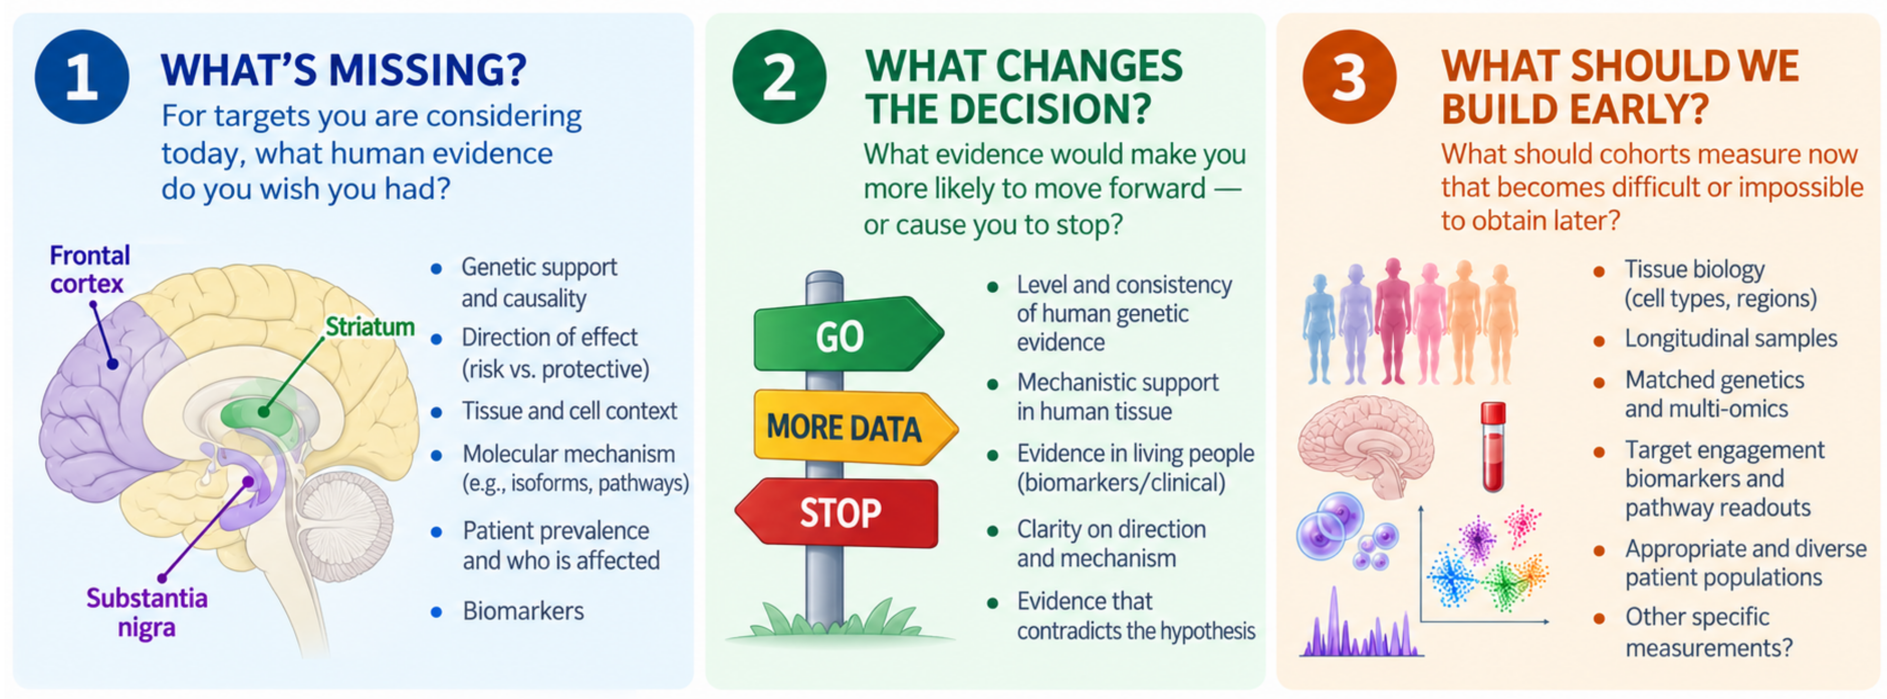
What Could We Add As We Build?
Omics use is growing fast. How can it best be used in these cohorts to inform PD?
We especially want to hear from: clinical trialists · drug-discovery and target teams · BD and strategy · biomarker developers

Slide 11
Backup: PPMI is the most-used PD cohort, and the newer resources are growing fastest
Publications naming each resource per year (Europe PMC: titles, abstracts and open-access full text), 2012–2025.
Resource | Papers naming it | In 2025 | Citations | Pharma co-authored
PPMI | 2,941 (since 2010) | 603 | ~90,200 | 130 (4%)
ASAP* | 1,016 (since 2020) | 335 | ~30,100 | 38 (4%)
AMP PD | 225 (since 2019) | 62 | ~5,300 | 18 (8%)
GP2 | 209 (since 2020) | 73 | ~4,500 | 6 (3%)
ADNI (AD, for scale) | 11,513 (since 2010) | 1,711 | — | —
Counts are papers naming each resource, not verified data use; open-access full text is searched, so coverage favours OA journals. *ASAP: mostly papers acknowledging ASAP funding. Pharma co-authored: ≥1 author at one of 30 pharma/biotech companies (Europe PMC affiliation search). Citations: Europe PMC citedByCount, Oct 2026. Data: pd_cohort_productivity.csv.
Notes:
BACKUP (Samantha) — use if asked how productive the cohorts are. PPMI papers grew from 239 (2020) to 603 (2025); ASAP 10 → 335, AMP PD 13 → 62, GP2 3 → 73. Mentions, not verified use; MJFF's own data-access and download statistics would complement these.

